Slide 1


CLICK
HERE
Predicting the Click Rate Of an Advertisement
Team 5 MSBA6330 Trend Marketplace Project -- 2019.12.11
Jie Liu, Olivia Liang, Dimo Liao,
William Wu, Batool Fatima, Wenqian Zhang
Notes:
Hello everyone, we are team 5. Today we will use a business case to explain how to leverage AWS for click prediction on big data.

Slide 2
Agenda
01
Context
02
Approach
03
Results
04
Next step
Notes:
This is our agenda today. We will firstly introduce the context of click prediction. Then we will explain our approach and introduce the different tools that we use. Then we will talk about the results and our next step.

Slide 3

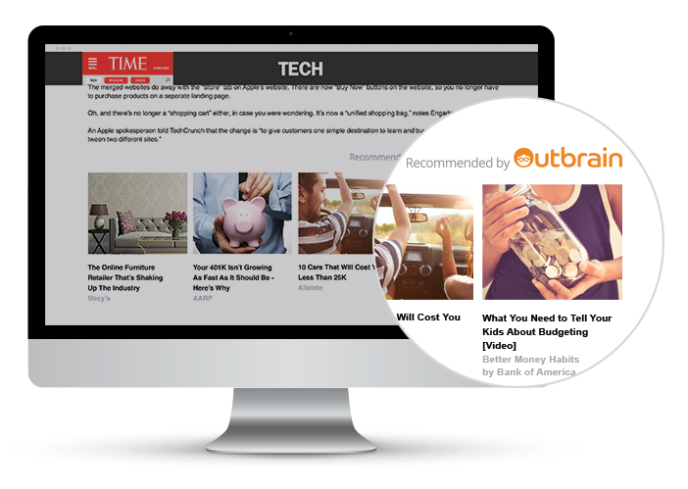
Outbrain maintains a network of publishers and advertisers.
Every click matters! it earns revenues by including ads and every click.
Notes:
Outbrain is a web’s leading content discovery platform, which maintains a network of publishers and advertisers. It pairs relevant content and readers with 250 billion personalized recommendations every month across several thousand sites. We will use outbrain as an example to explain how to leverage AWS for click prediction.
You can see the picture in the left side. For the TIME website, there are several advertisements that is recommended by outbrain. Every click matters because it earns revenues by including ads among recommended stories and clicks from users.

Slide 4

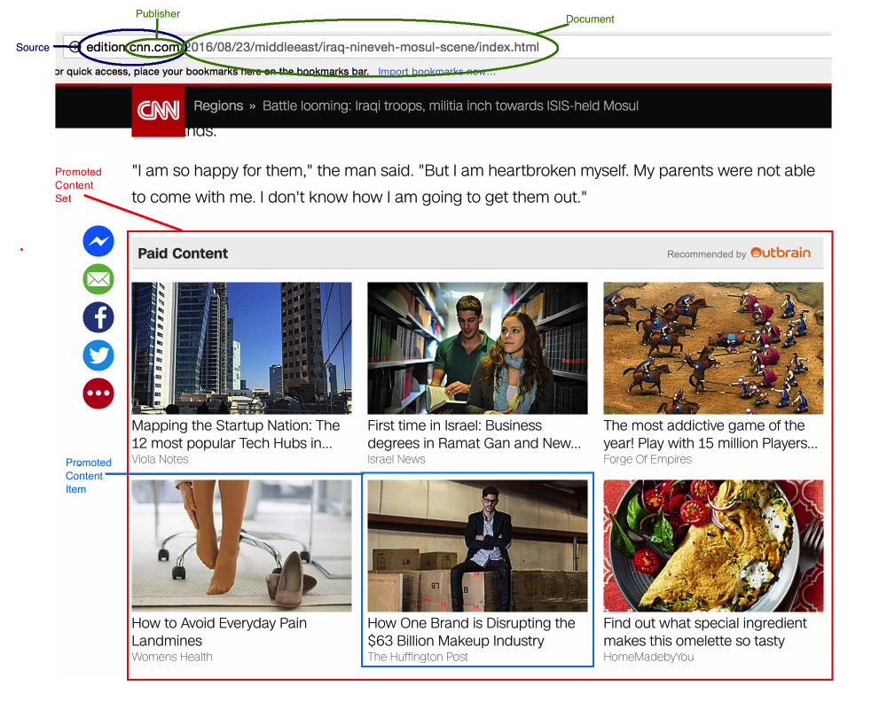
Improve CTR
Predict
which pieces of content
its users are likely to
click on！
Notes:
Since every click matters, we want to know how to improve CTR, which is short for click through rate. a metric that measures the number of clicks advertisers receive on their ads per number of impressions. CTR prediction is very relevant for industries like e-commerce and advertisement, as tiny improvements in user conversion may lead to significant increases in profits, also providing a better user experience.
For example, this screenshot shows paid content (ads) are presented to a user in a CNN (publisher) news page.
We want to predict which pieces of content its users are likely to click on.

Slide 5

Data Description
Kaggle.com
Data source
700 million
Unique users
>100 GB
Data size
2 billion
Page views
17 million
Click records
11
Data files
Notes:
The data is available at kaggle.com. We get two data set from kaggle, one is training set and another one is test set. For training set, it’s 23 gb and has more than 2 years records. For the test set, it’s 7 gb and has 5 and a half months records. Both have 60 variable.

Slide 6
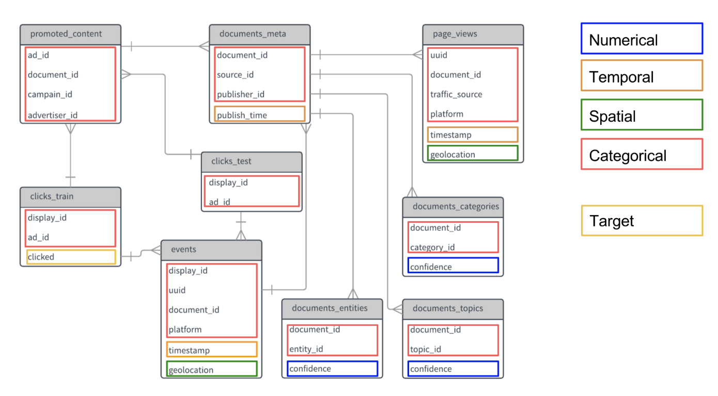
Data Structure
https://medium.com/unstructured/how-feature-engineering-can-help-you-do-well-in-a-kaggle-competition-part-i-9cc9a883514d

Slide 7
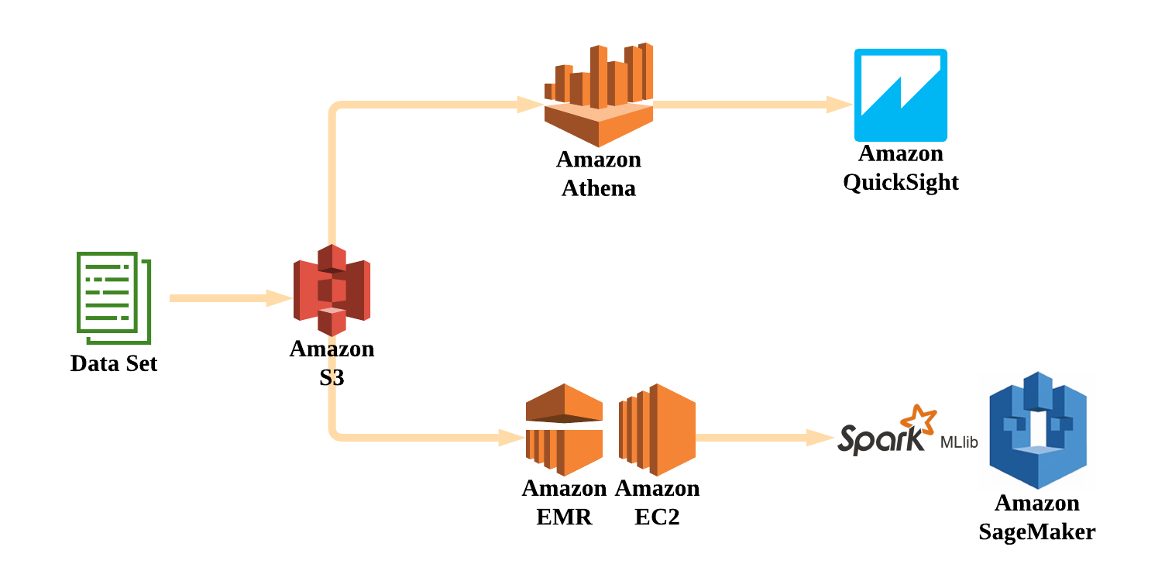
Approach
Pre-processing Data with SQL
Interactive Report
Data Source
Data Storage
Feature Engineering
Click Prediction

Slide 8
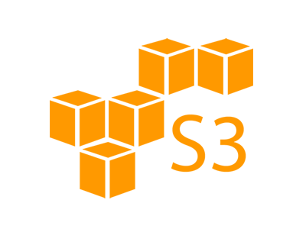
Data Storage
Amazon S3 (Simple Storage Service) can be used to store and retrieve data anywhere from the web
Notes:
https://aws.amazon.com/s3/?nc=sn&loc=1
S3 - is an object storage service that offers industry-leading scalability, data availability, security, and performance.
Benefits: store, analyse and retrieve large data from different platforms only pay for your what you use

Slide 9

Simple Querying
Amazon Athena makes it easy to analyze data directly in Amazon S3
No infrastructure to set up or manage
You pay only for running query
Notes:
Amazon Athena is an interactive query service that makes it easy to analyze data directly in Amazon Simple Storage Service (Amazon S3) using standard SQL. With a few actions in the AWS Management Console, you can point Athena at your data stored in Amazon S3 and begin using standard SQL to run ad-hoc queries and get results in seconds.
Athena is serverless, so there is no infrastructure to set up or manage, and you pay only for the queries you run. Athena scales automatically—executing queries in parallel—so results are fast, even with large datasets and complex queriesyou use

Slide 10
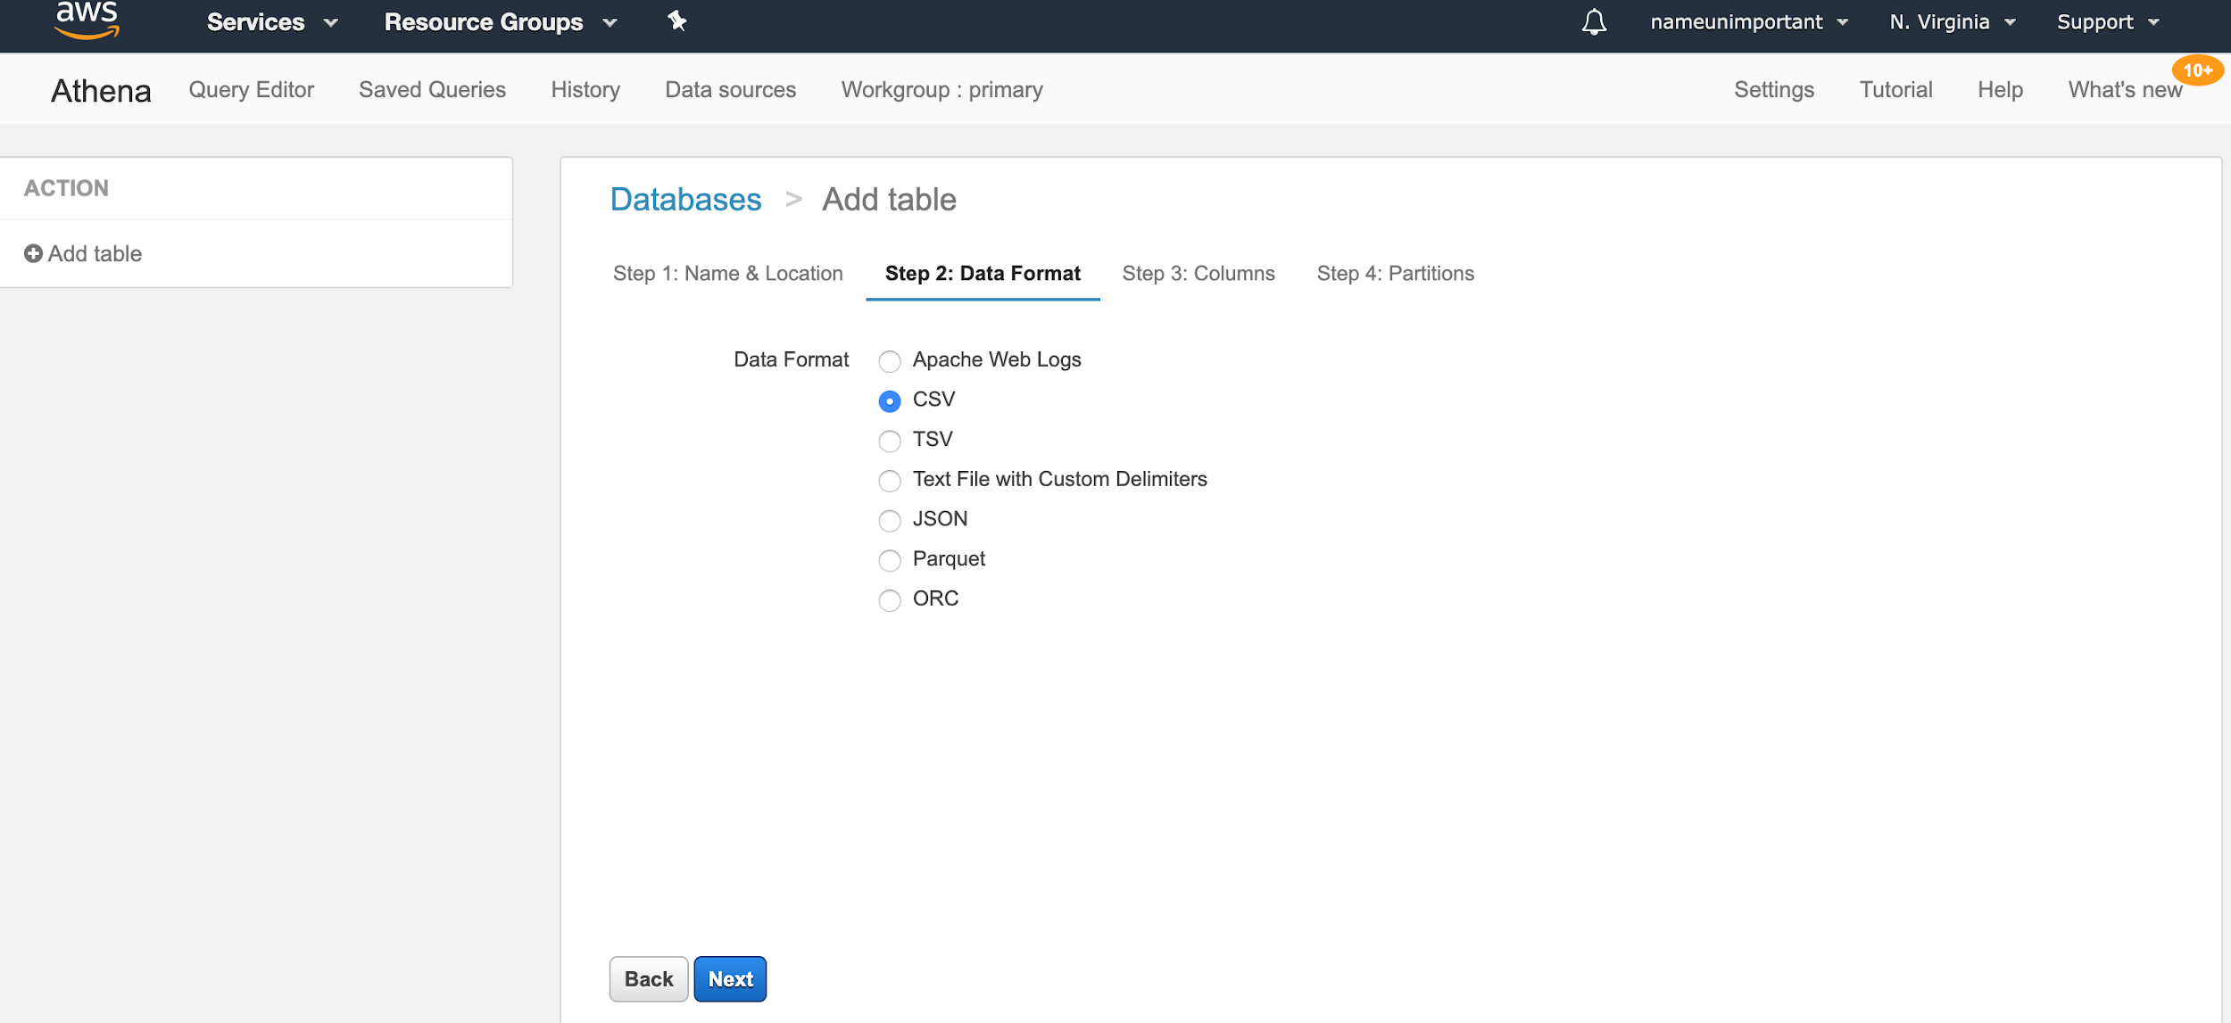
An interactive way of creating table
Notes:
Amazon Athena is an interactive query service that makes it easy to analyze data directly from S3 using Standard SQL.
Benefits
1. Easy to Use: Presto SQL
2. Simple Price: Pay only for data scanned: $5/T
3. Query data directly from S3
4. Fast

Slide 11
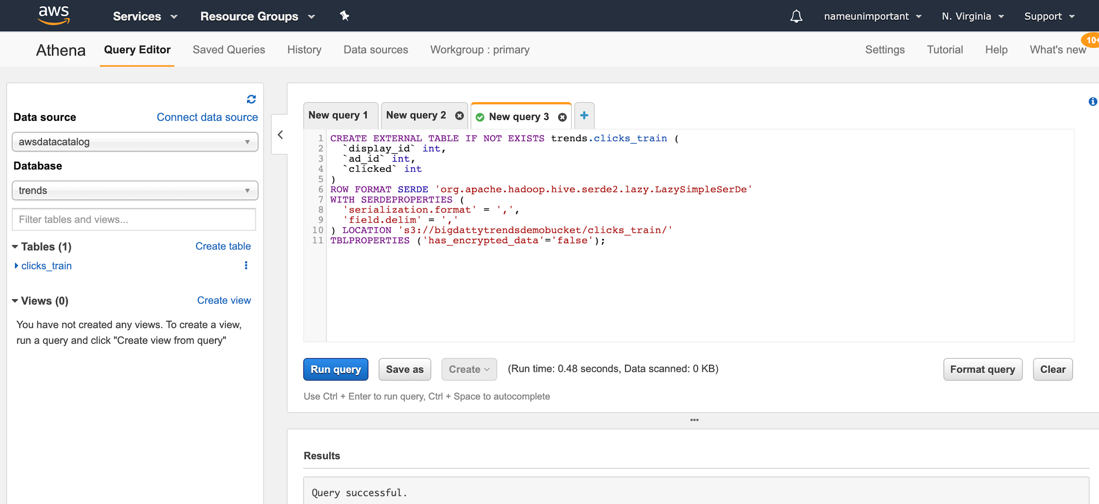
Querying in parallel
Notes:
Amazon Athena is an interactive query service that makes it easy to analyze data directly from S3 using Standard SQL.
Benefits
1. Easy to Use: Presto SQL
2. Simple Price: Pay only for data scanned: $5/T
3. Query data directly from S3
4. Fast

Slide 12

Visualization
QuickSight - a fast, cloud-powered business intelligence service that makes it easy to deliver insights to everyone in your organization.

Slide 13
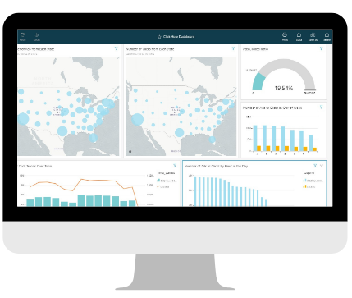
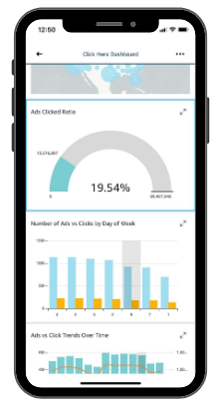
QuickSight Dashboard (Website and Mobile)

Slide 14


Data Mining
EMR - a managed cluster platform that simplifies running big data frameworks
EC2 - offers scalable compute capacity in the cloud
Notes:
EC2 - is a web service that provides secure, scalable compute capacity in the cloud.
EMR - is the industry leading cloud-native big data platform for processing vast amounts of data quickly and cost-effectively at scale. EMR pricing is simple and predictable: You pay a per-instance rate for every second used, with a one-minute minimum charge. With EMR, you can provision one, hundreds, or thousands of compute instances to process data at any scale.

Slide 15

Machine Learning
Data Pre- processing
Select Algorithm & framework
Train & tune your model
Integrate & Deploy
Sagemaker - helps to build, train, and deploy machine learning (ML) models quickly.
Support frameworks include TensorFlow, Keras, Scikit-learn and etc.
Notes:
Automatically build, train, and tune models with full visibility and control, using Amazon SageMaker Autopilot
Build and collaborate faster using Amazon SageMaker Notebooks
Amazon SageMaker supports the leading deep learning frameworks
Supported frameworks include TensorFlow, PyTorch, Apache MXNet, Chainer, Keras, Gluon, Horovod, Scikit-learn, and Deep Graph Library.

Slide 16
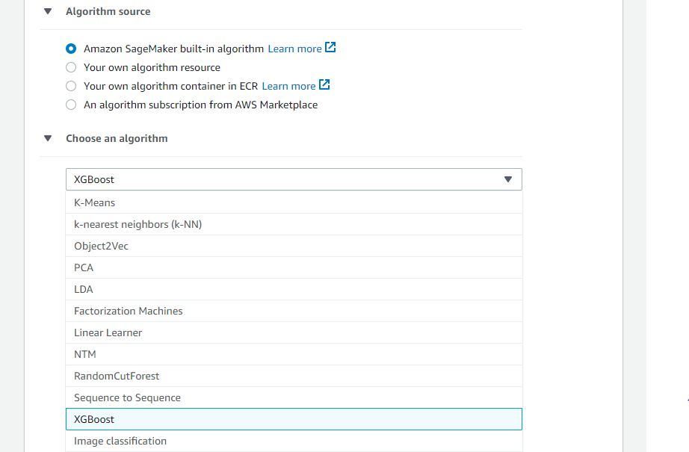
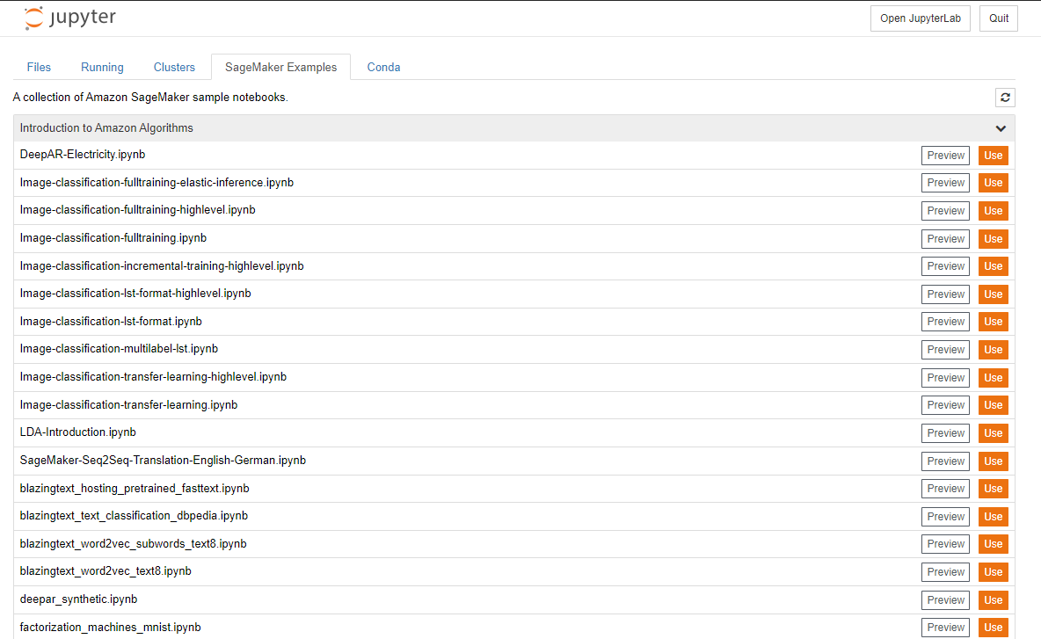
Click Prediction on SageMaker
Reduce ML Complexity
Provide Independency
Build your ML algorithm by clicking
Use template code with detailed Tutorials

Slide 17
Click Prediction on SageMaker
Basic Features considered for Click Prediction
Click Through Rate
Popularity of the webpage
Topic Similarity between User Preference and the ad (*)
Kaggle 0.635
Create Training Job
On SageMaker
Our model in SageMaker 0.734

Slide 18

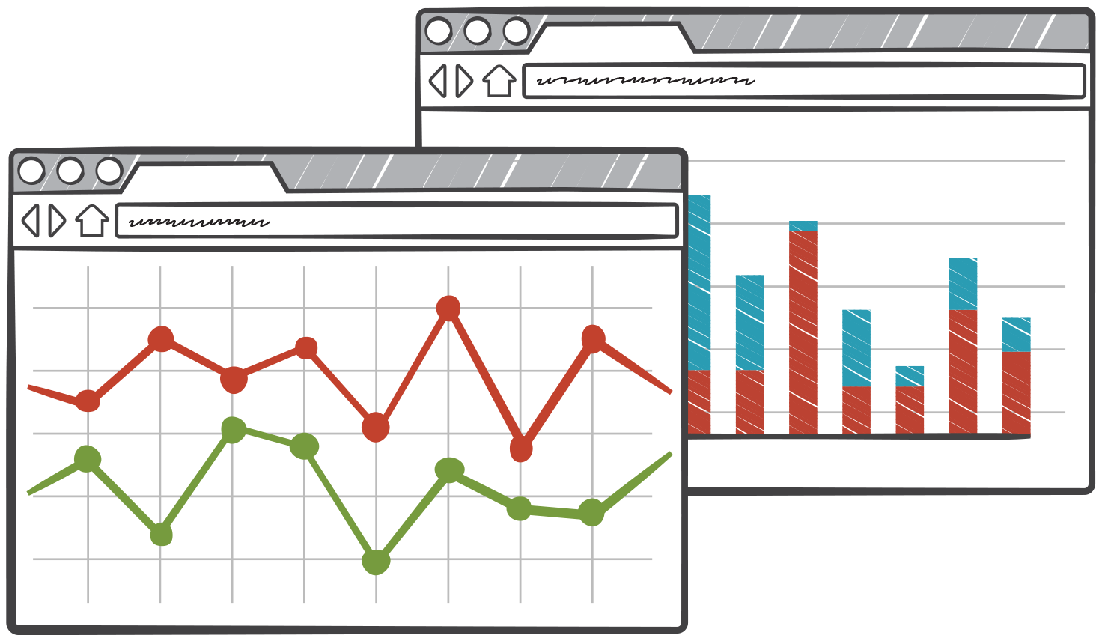


Business Value
Easy to Use
Secure and Reliable
All-in-1 Ecosystem
Cost Efficient
Notes:
Easy to Use
Handling Problems in 1 Ecosystem - AWS
Spending Budget Efficiently
Secure and Reliable
Applicable in Other Industries

Slide 19

Thank You!

Slide 20
Sources
Data: https://www.kaggle.com/c/outbrain-click-prediction/data
AWS: https://docs.aws.amazon.com/
Notes:
Citation athena : Hoena, B. A., and Laurel Bowman. “Athena.” Amazon, Capstone Press, 2003, docs.aws.amazon.com/athena/latest/ug/what-is.html.

